Slide 1

CPU

Slide 2
What is CPU
Definition: CPU is short for Central Processing Unit. The CPU can be thought of as the brains of the computer system. Often people mistake the case or chassis of their computer as the CPU. The CPU is actually an internal component of the computer that can not bee seen from the outside of the system, or the inside without removing the CPU heatsink and fan. A CPU is commonly the most expensive component of a computer and is very sensitive to static electricity.

Slide 3
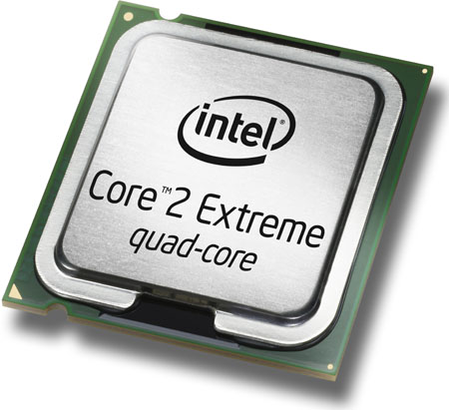

Slide 4
The CPU, which stands for Central Processing Unit, is the brains of the PC. It is also referred to as a "processor" or "chip". The CPU directs, coordinates and communicates with the hardware components and performs all of the "thinking". What a CPU actually does is perform mathematical calculations. It is the software that people write that translates those calculations into useful functions for us.

Slide 5
The speed of the CPU, generally speaking, is the number of calculations it can perform in one second. It is more complicated than that, but that is a reasonable way to think of the speed. A 500 MHz (megahertz) CPU performs about 500,000,000 mathematical calculations per second.
As the speed of new CPUs increase, the difference is becoming less obvious to computer users. A CPU that is twice as fast as another one will not result in a PC running twice as fast. The CPU has to wait for other, slower components and for the user too. The CPU spends a lot of time sitting idle, waiting for something to do. For example, it waits for you to press a key or for the hard drive to retrieve some data or the video card to draw what will appear on the screen.

Slide 6
CPUs now have something called a "cache" or memory cache. The memory cache is where information is stored that the CPU is likely to need soon. This memory is in addition to the normal memory installed in a PC. The difference is that the cache is built right into the CPU, and it is much faster. Cache memory was invented to help reduce the time the CPU had to wait while information was retrieved from the standard memory.
The two largest CPU manufacturers are Intel and Advanced Micro Devices (AMD). Their products compete head to head and are substantially similar. The CPUs from these rivals each have their own champions and will tell you why one chip is better than the other. The key difference for you may simply be price or speed.

Slide 7
There have been several generations of processors. The tables below delineate the processor and the year of release.

Slide 8
Processor Name | Years
8086-8088 | 1978
286 | 1982
386 | 1985
486 | 1989
Pentium | 1993
Pentium Pro | 1995
Pentium II | 1997
Pentium II Xeon | 1998
Celeron | 1999
Pentium III | 1999
Pentium III Xeon | 1999
Processor Name | Years
Pentium 4 | 2000
Xeon | 2001
Itanium | 2001
Itanium 2 | 2002
Pentium M (Centrino) | 2003

Slide 9
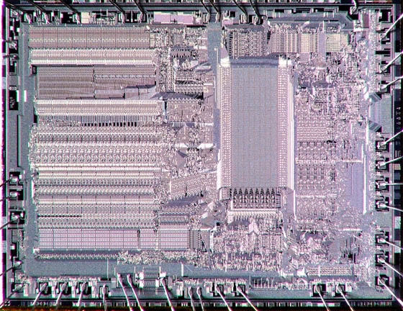
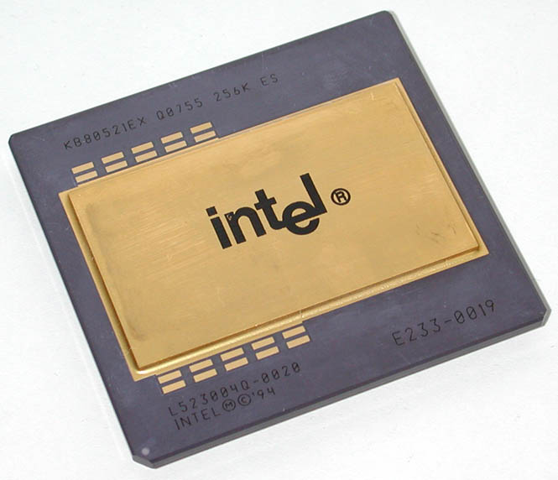
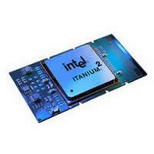
Intel 8086-8088 Intel pentium pro
        Intel Itanium 2

Slide 10
AMD
Processor Name | Year
386DX | 1989
486 | ?
486DX2 | 1992
486DX4 | 1994
486DX5, 5X86 | 1995
K5 | 1996
K6 | 1997
Athlon (K7) | 1998
Duron | 2000
Opteron (K8) | 2003

Slide 11
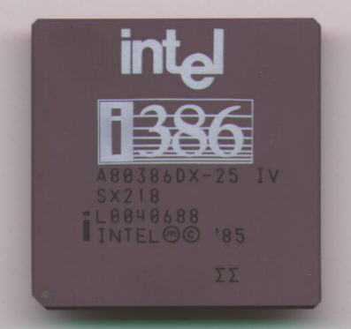
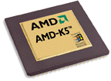
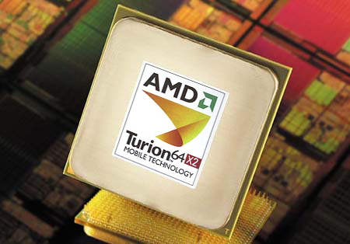
AMD 386DX AMD K5
        AMD Opteron (K8)

Slide 12
Choosing a CPU
As to which brand to choose, you are probably already leaning toward one. There may be a deep technical reason why you would choose one over the other, or you may have a preference based upon marketing or a recommendation. Both companies' products are reliable and they split the market almost down the middle. So if you don't have a specific technical reason for choosing one, either one should be fine.
As to what speed to select; the price for the latest, fastest CPU is always at the top of the price curve. As you move back to slower CPUs the price drops dramatically. The oldest nearly-out-of-production CPUs are downright cheap; but not that much cheaper than the middle of the pack.

Slide 13
Therefore the best bang for your buck is usually in the middle of the speed range. If the currently available CPUs ranged from 900 MHz, 1.2 GHz, 2.4 GHz through 2.8 GHz and 3.2 GHz, the 3.2 GHZ would be too expensive. The 900 MHz would be cheap, but the 1.2 GHz would be only a few dollars more and the 2.4 GHz only a few dollars more than that. So the best deal is usually the CPU that is about two speeds slower than the fastest currently available.
Another aspect of choosing a CPU is whether you have some specific CPU requirements to run the software you want to use. You have to meet or exceed the speed requirements of each of your software programs. This isn't hard to do because the CPUs today far outstrip the requirements of nearly all software. You should anticipate the demands of future programs you might want to use, but it is, at best, difficult to predict.

Slide 14
Made by : ARD GAFURRI & DREN ZHUBI
Class 9E

